Slide 1





Sao Paulo, Brazil October 2014
Quantitative modelling of electron transport using DFT
Ivan Rungger, Amaury de Melo Souza and Stefano Sanvito
School of Physics and CRANN, Trinity College Dublin, IRELAND
Notes:
1

Slide 2
Outline
Lecture 1: Practical introduction to quantum transport
Why is it important?
From simple models to NEGF
Inelastic scattering within NEGF
Lecture 2: Is DFT-transport predictive?
DFT based electron transport
Problems with DFT for transport through molecules
Master equation approach
Lecture 3: Solid state spin-electronics devices
Magnetoresistance in magnetic tunnel junctions
Spin transfer torque
Strong correlations: Kondo effect
Notes:
2
Mention: “is it predictive”: once we know all atomic positions, can we predict the transport properties?

Slide 3
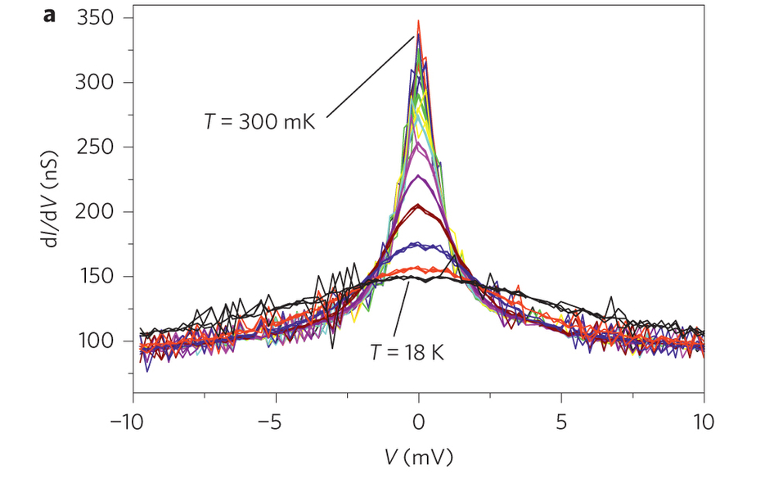
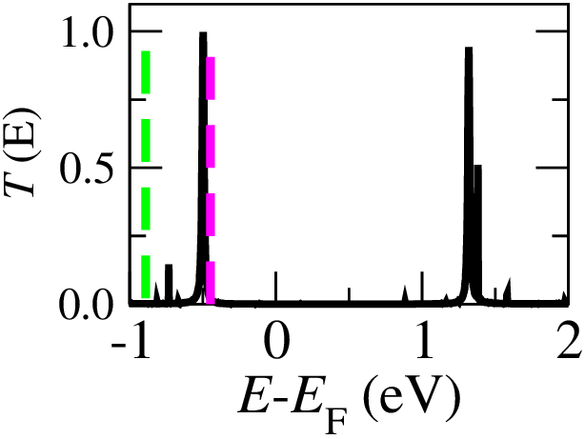
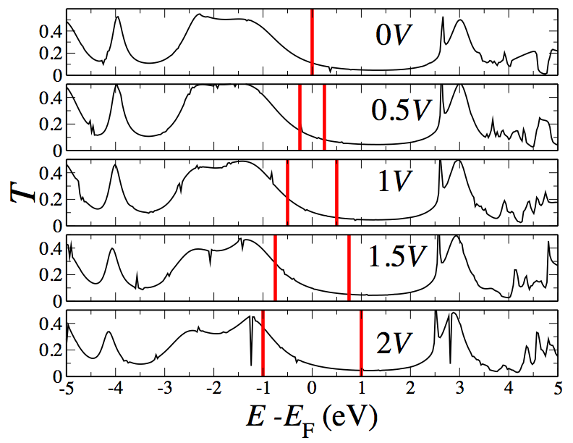
Yesterday’s lectures
Strong coupling
Intermediate coupling
Weak coupling
NEGF
Kondo
Coulomb blockade
DFT+GW transport results
M. Strange et al., PRB 83, 115108 (2011)
Notes:
Mention:
that GW does not really work for Kondo physics

Slide 4
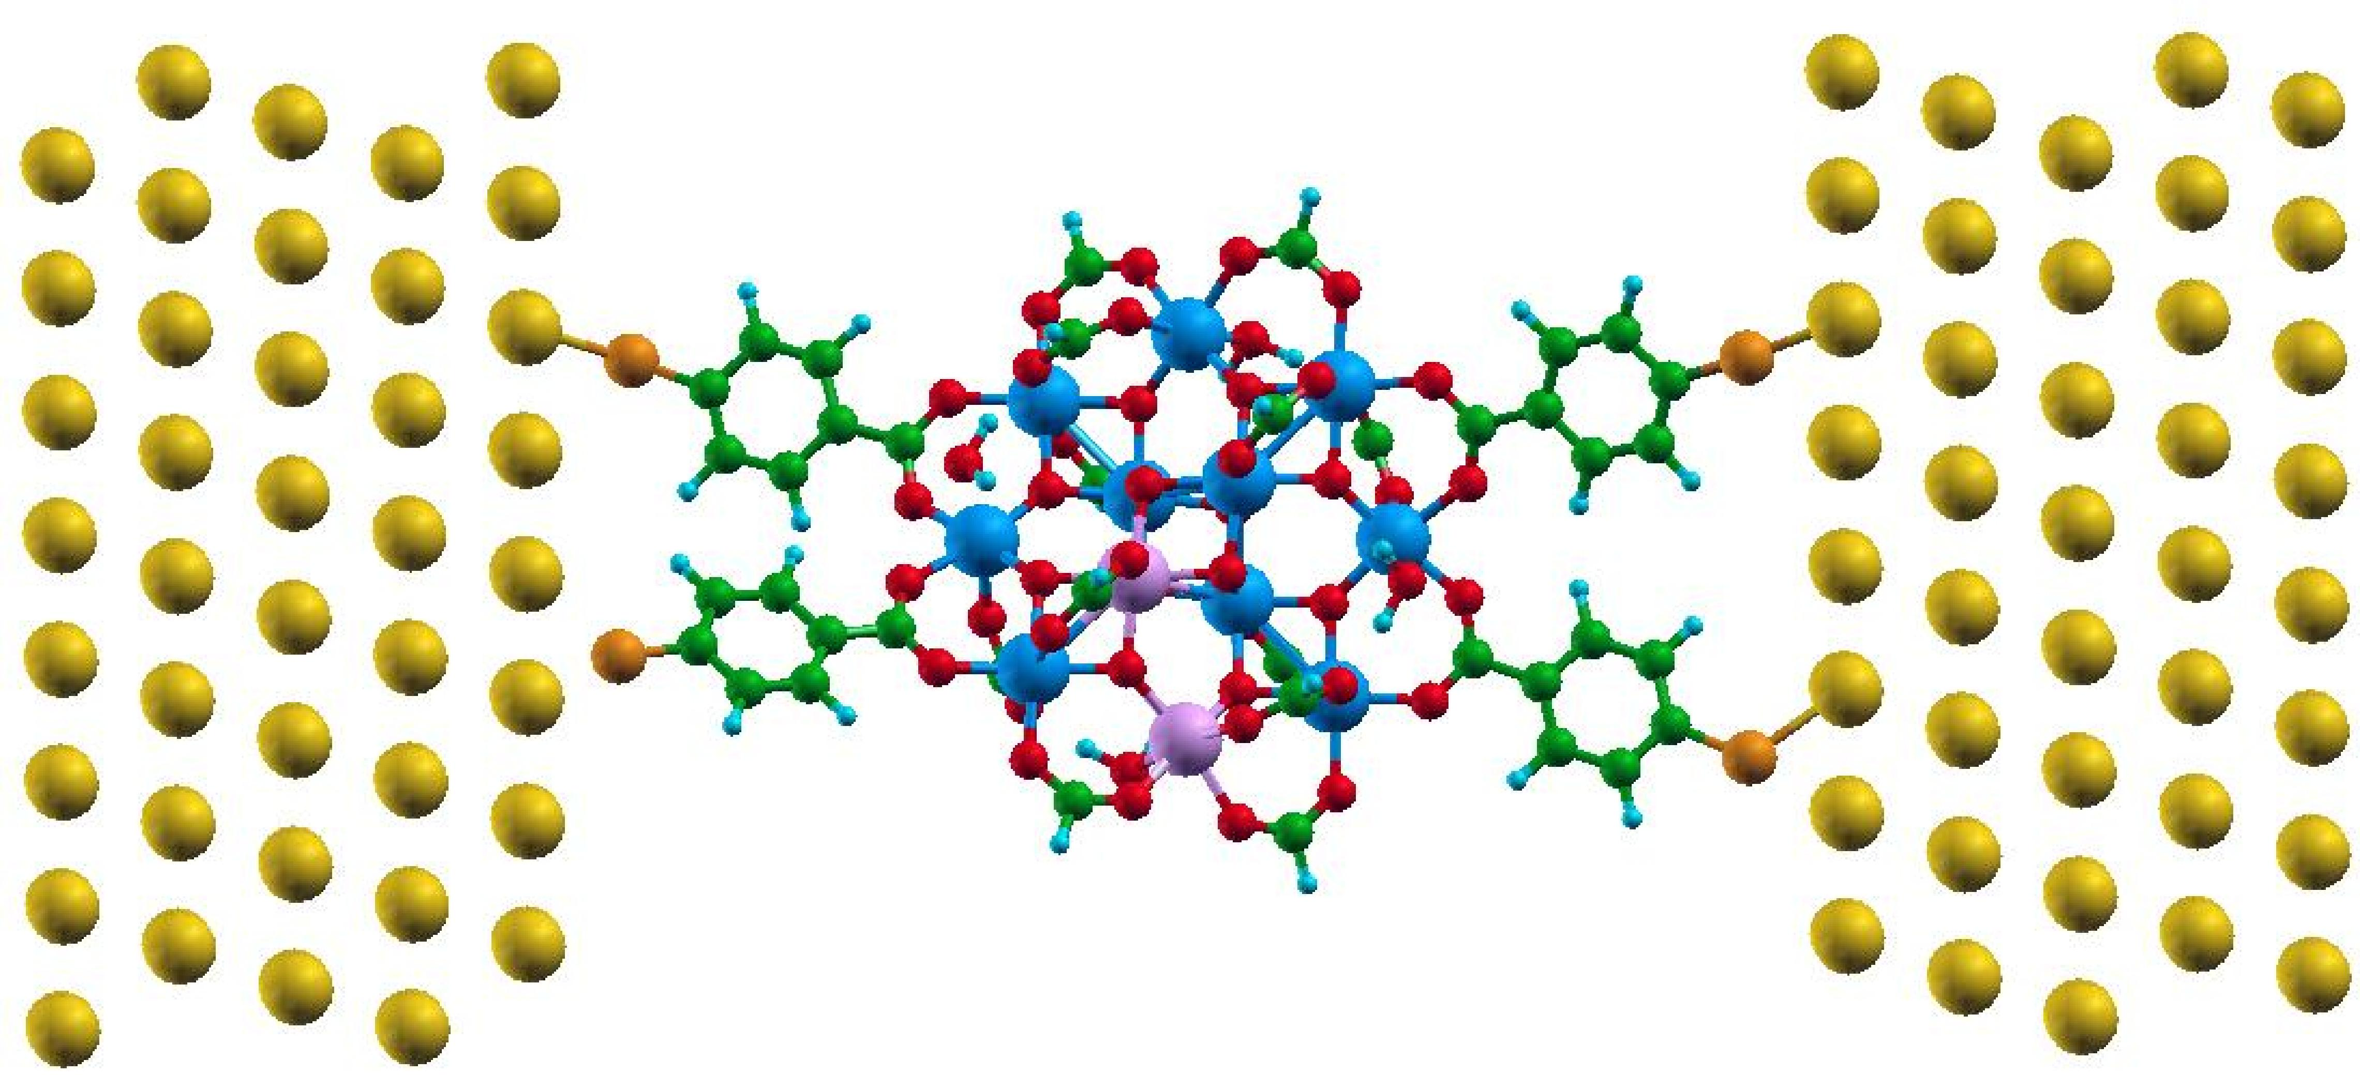
Let’s remind ourselves what we covered last time…
Density Functional Theory
Non-equilibrium Green’s functions

Slide 5
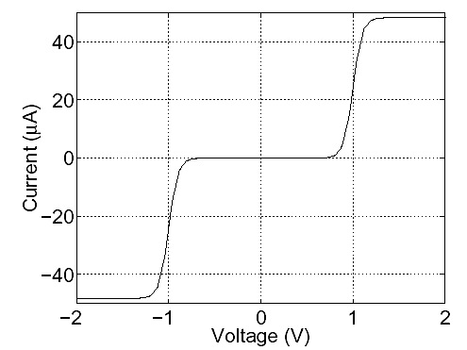
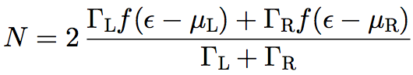
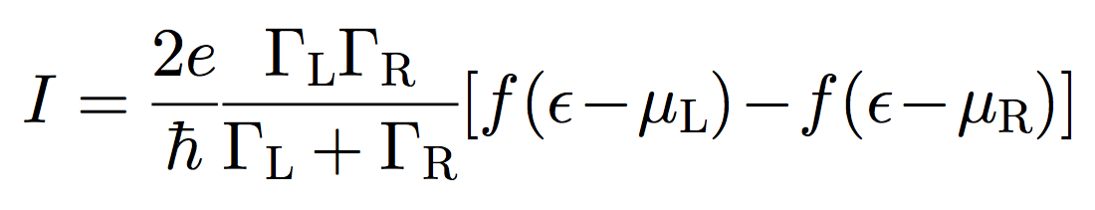
Occupation and current
Energy
μ_{L}
μ_{R}
EF
Γ
Γ
Au
Au
V≠0
V=0
Notes:
5

Slide 6
From single level to atomistic
NEGF
H_{L} [ρ_{L} ]
Σ_{L}
+
H_{M} [ρ]
+
H_{R} [ρ_{R} ]
Σ_{R}
I

Slide 7
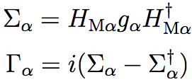
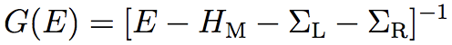
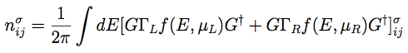
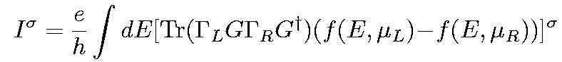
From single level to atomistic
A. R. Rocha and S. Sanvito, PRB 70, 094406 (2004)

Slide 8
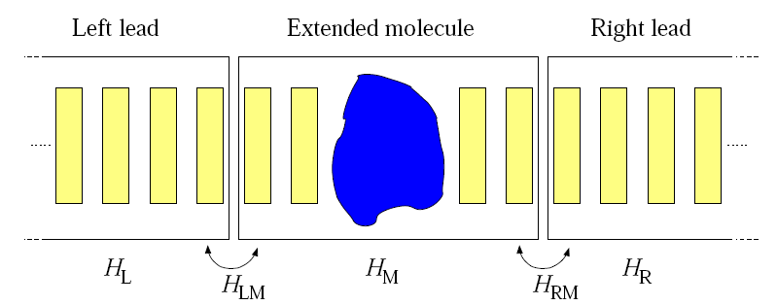
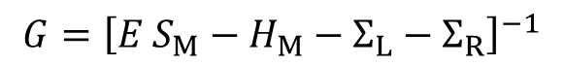
Smeagol: first principles electron transport
Density Functional Theory (DFT)
+
Non-equilibrium Green’s functions (NEGF)
I
$$G={\left[E S_{M}−H_{M}−Σ_{L}−Σ_{R}\right]}^{−1}$$
SMEAGOL (NEGF): A. R. Rocha et al., PRB 73, 085414 (2006); Nature Materials 4, 335 (2005);
I. Rungger et al., PRB 78, 035407 (2008); http://www.smeagol.tcd.ie
SIESTA (DFT): J. Soler et al., J. Phys.: Condens. Matter 14, 2745 (2002)
Notes:
8

Slide 9
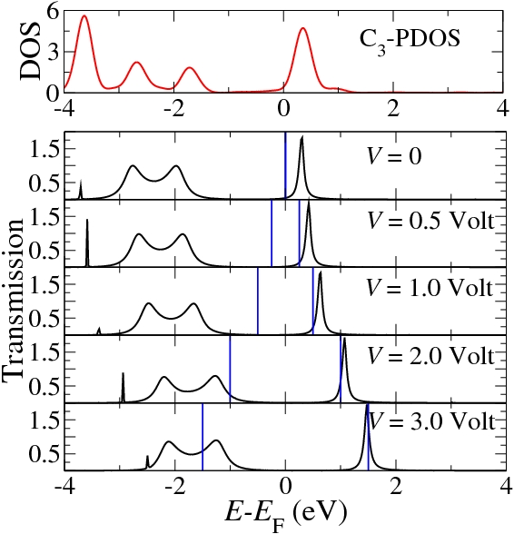
How to read the results ?

Slide 10

How to read the results ?
Zero-bias: level alignment
E_{F}
HOMO
HOMO
HOMO
LUMO
LUMO
LUMO
DOS
E
H_{M}+ReΣ
H_{M}+ReΣ
H_{M}+ReΣ+ImΣ

Slide 11
How to read the results ?
E_{F}
HOMO
LUMO
DOS
I∝∫ T(E) dE
E
T(E)~(DOSx ImΣ )²
I
HOMO
LUMO
T(E)
E_{F}+eV/2
V
E_{F}-eV/2
E_{F}
E

Slide 12
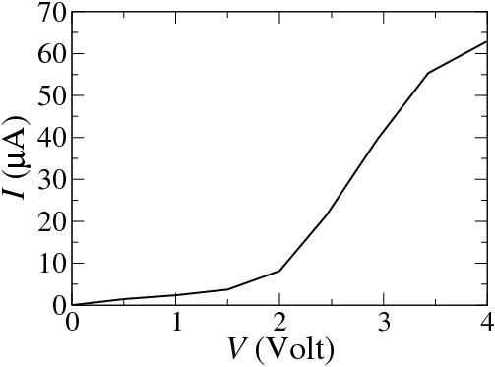
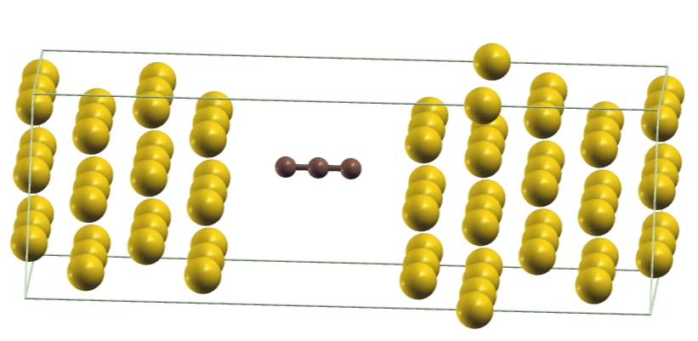
How to read the results ?

Slide 13
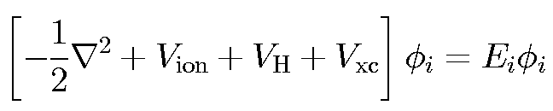
Density Functional Theory
Hohenberg-Kohn Theorem
The ground state energy E_{N} of a system of N electrons (interacting!!) is a unique, universal functional of the single particle charge density ρ(r)
E_{N}[ρ]=T[ρ]+E_{C}[ρ]+E_{ion}[ρ]+E_{XC}[ρ]
Moreover the ground state charge density ρ_{GS} is such that:
E_{N}[ρ_{GS}]<E_{N}[ρ]
Kohn-Sham formulation
The search for ρ_{GS} can be obtained by solving a single-particle problem for a fictitious system of non-interacting particles
Notes:
Mention: is it justified to use V and Ei and phi-I from DFT as single particles states to then compute the transport?
Yes and no

Slide 14
Problems, problems, problems…
Notes:
14
Mention: what do I have to do to get correct/physically meaningful results?

Slide 15
Level alignment problem
Notes:
15

Slide 16
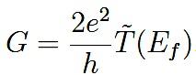
Quantum transport
The position of the DFT energy levels dictates the conductance
Energy
μ1
μ2
γ
γ
Au
Au

Slide 17
Quantum transport
Vacuum
EA
WF
E
F
IP

Slide 18
Ionization potential and electron affinity
molecule
E(N)
e⁻
hv
Ionization potential
molecule
E(N-1)
IP = E(N)-E(N-1)
e⁻
hv
Electron affinity
molecule
E(N+1)
EA =E(N)-E(N+1)
For molecules DFT total energy difference usually gives good IP and EA values (Δ-SCF method)
Notes:
Mention: photo emission experiments for IP, and inverse photoemission for EA

Slide 19
Ionization potential and electron affinity
ε_{LUMO} ≠-EA
ε_{LUMO}
Energy
In general for the exact KS potential:
ε_{HOMO} = -IP
ε_{HOMO}
However standard LDA/GGA gets both wrong
Gas-phase molecule

Slide 20
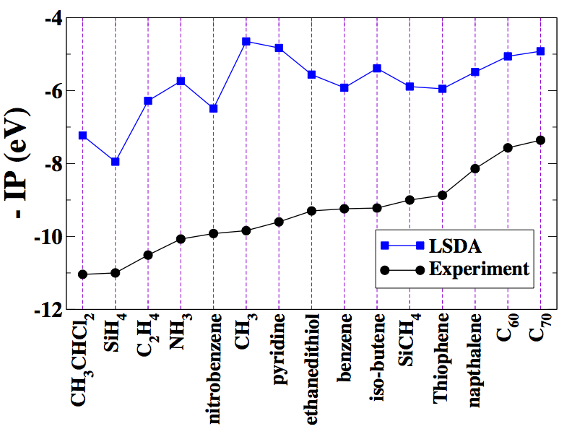
LDA versus experiment
LDA seems useless
ε_{HOMO} ≠ -IP

Slide 21
Can we improve it?
ε_{LUMO} <-EA
ε_{HOMO} > -IP
LDA/GGA DFT
ε_{LUMO} >-EA
ε_{HOMO} < -IP
Hartree-Fock
Let’s mix them: hybrid functionals
ε_{LUMO} ≈-EA
ε_{HOMO} ≈ -IP
B3LYP, HSE, PBE0
Quasiparticle theory
ε_{LUMO} ≈-EA
ε_{HOMO} ≈ -IP
GW
Quantum chemistry methods (MP2, CC)…
Notes:
Mention:
hybrid functionals (LDA underestimates HOMOLUMO gap, HartreeFock overestimates it, so we mix the two to get a good gap).

Slide 22
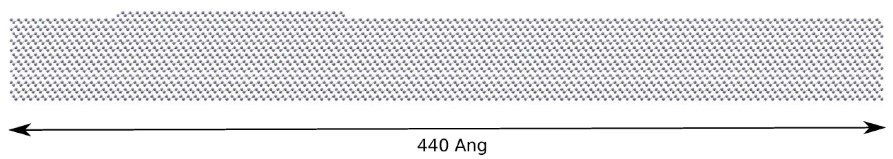
Why DFT???
Large systems
DNA transport
Transport in solution
I. Rungger et al., PRB 81, 235407 (2010)
C. D. Pemmaraju et al., PRB 82, 125426 (2010)
Topological insulators
A. Narayan, IR et al., PRB 86, 201402(R) (2012)
Works well for the metal electrodes, workfunctions are good (!)

Slide 23

The self-interaction error seems to be the problem
Notes:
Mention: example with H atom (single electron interacting with its own exchange correlation, hartree potential)

Slide 24
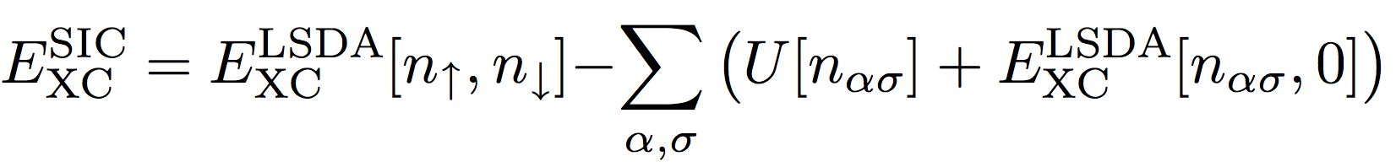
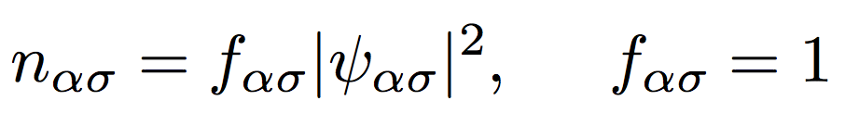
Self-interaction
Direct subtraction
J.P. Perdew and A. Zunger, Phys. Rev. B 23, 5048 (1981)
Kohn-Sham orbitals

Slide 25
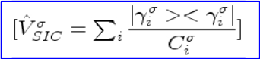
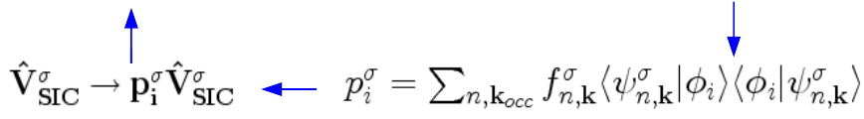
Self-interaction
Pseudo-SIC (Atomic-SIC)
=α
i runs over Atomic orbitals
α : Scaling parameter between 0 (LDA) and 1 (full SIC)
D. Vogel, P. Krüger and J. Pollmann, Phys. Rev. B 54, 5495 (1996)
A. Filippetti and N.A. Spaldin, Phys. Rev. B 67, 125109 (2003)
C. Das Pemmaraju et al., PRB 75, 045101 (2007)

Slide 26
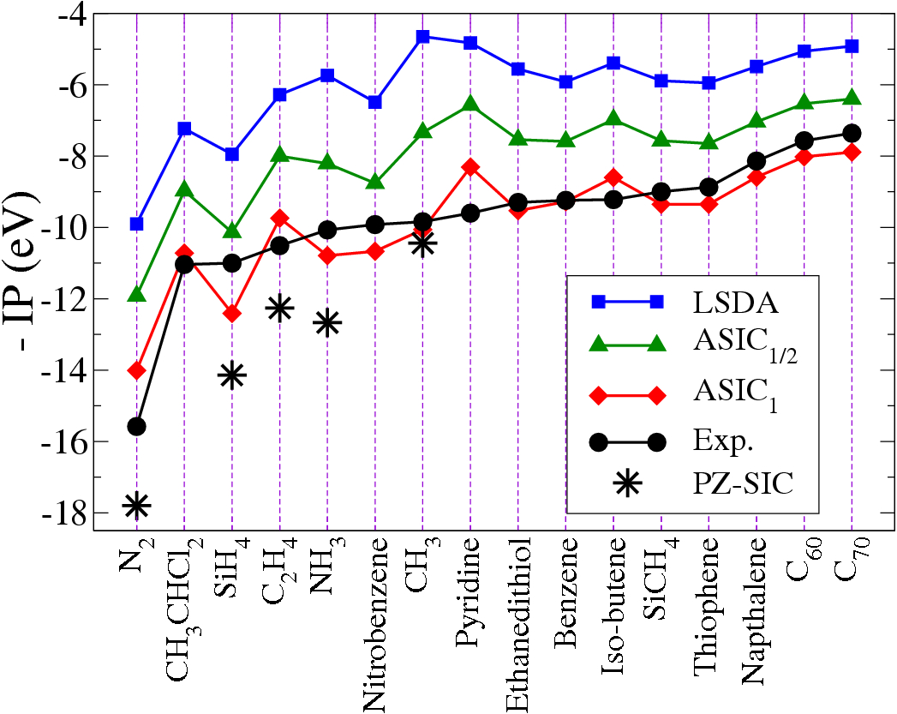
Self-interaction
ε_{HOMO} ~ -IP
C. Das Pemmaraju, T. Archer, D.Sanchez-Portal and S. Sanvito, PRB 75, 045101 (2007)

Slide 27
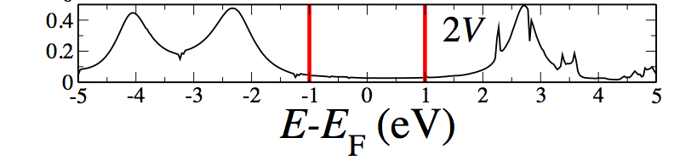
Self-interaction and transport
LSDA
G=0.23G₀
P-SIC
G=0.06G₀
C. Toher et al., PRL 99, 056801 (2007)
Experiment: G=0.01 G₀

Slide 28
Problems, problems, problems…
Notes:
28

Slide 29
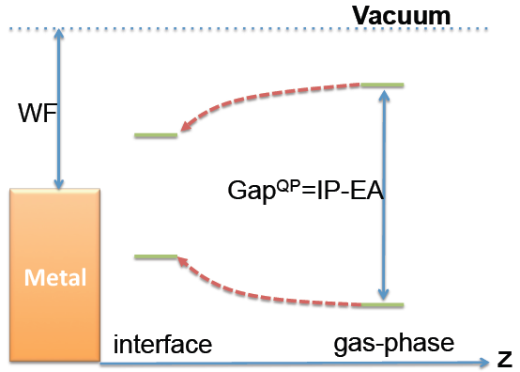
Organic/inorganic interfaces
e⁻
e⁻
hv
IP (PES)
hv
EA (IPES)
molecule
molecule
d
d
Metal
Metal
G. Onida, L. Reining, A. Rubio. Rev. Mod. Phys., 74, April, 2002.
Notes:
The KS scheme does not capture (Eigenvalues!) But DFT as a Total energy theory does capture this effect! We want to demonstrate this!

Slide 30
Organic/inorganic interfaces
e⁻
e⁻
hv
IP (PES)
hv
EA (IPES)
molecule
molecule
d
d
Metal
Metal
Density Functional Theory:
Kohn-Sham scheme with semi-local exchange correlation functionals does not capture these non-local correlation effects!
G. Onida, L. Reining, A. Rubio. Rev. Mod. Phys., 74, April, 2002.

Slide 31
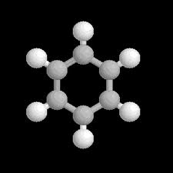
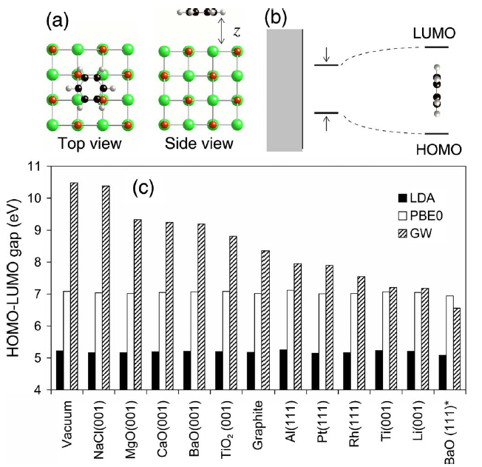
Organic/inorganic interfaces
J. M. Garcia-Lastra et al. Phys. Rev. B, 80, 245427 (2009).
< ~3.2eV at 4.5Å
GW
J. B. Neaton et al. Phys. Rev. Lett, 97, 216405 (2006).
J. Garcia-Lastra et al. Phys. Rev. Lett, 106, 18 (2011).
Isaac Tamblyn et al. Phys. Rev. B, 84, 201402 (2011).
M. Strange, Phys. Rev. B, 86, 195121 (2012).
Scissor operator, DFT+Σ
V. M. Garcia-Soarez et al., New J. Phys. 13, 053026 (2011).
Su Ying Quek et al. NanoLett. 7, 3477 (2007).
Constrained-DFT
Jay Sau et. al, Phys. Rev. Lett. 101, 11 (2008).

Slide 32
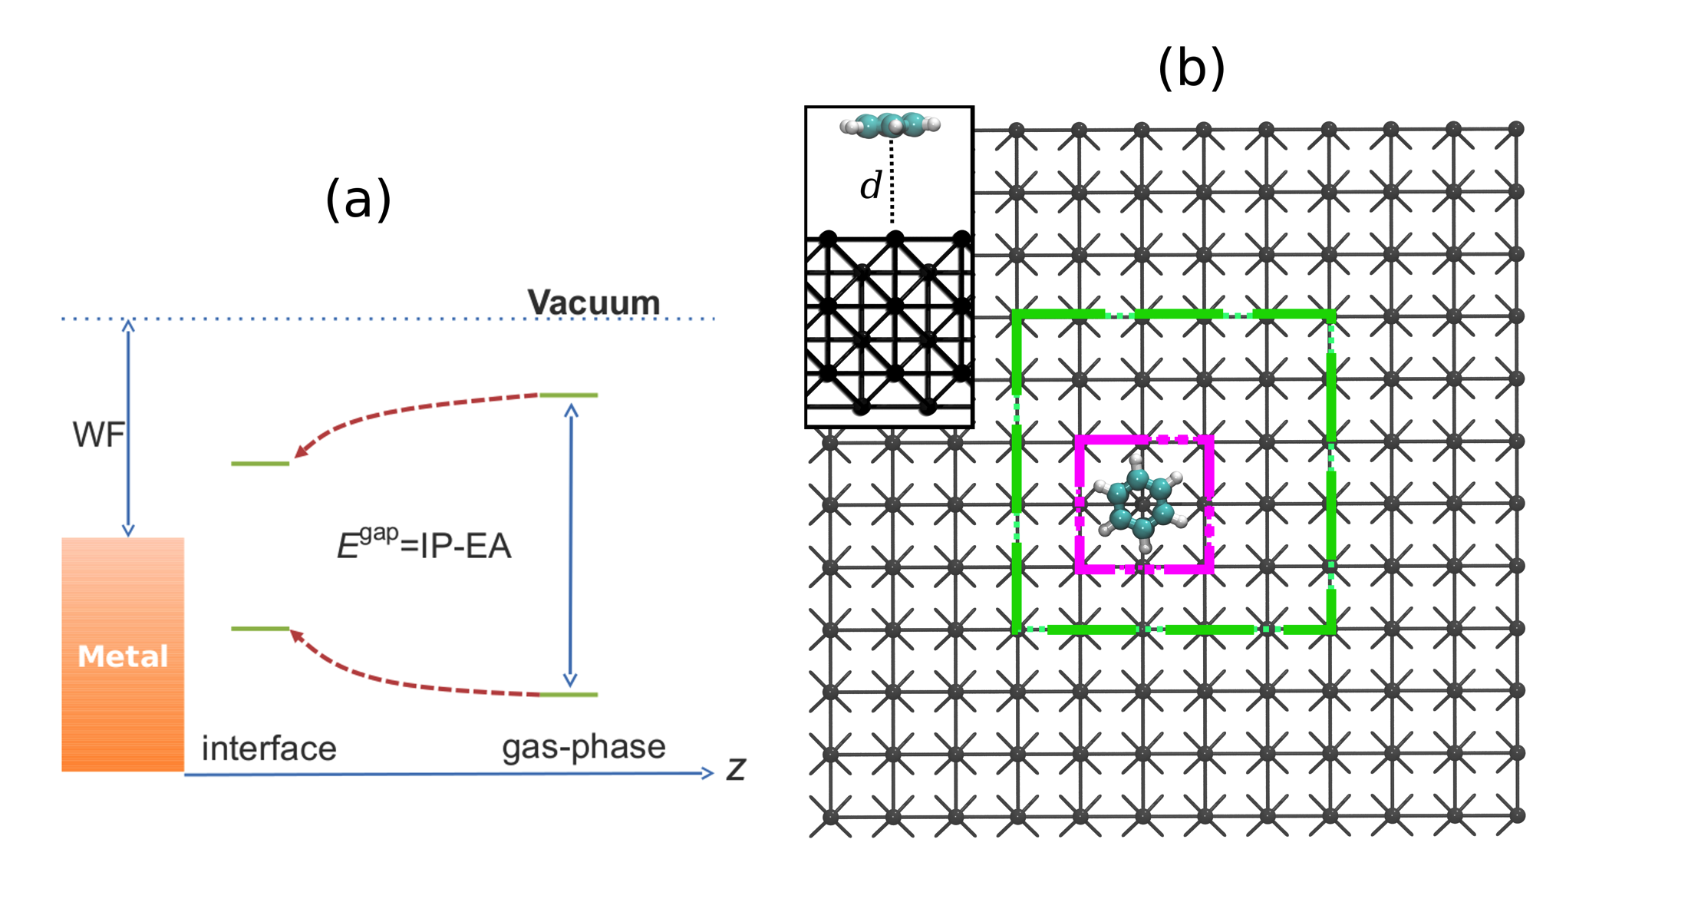
A benchmark system: Benzene/Li interface
12x12
Li (001)

Slide 33
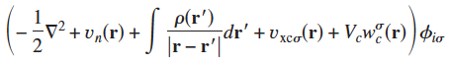
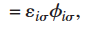
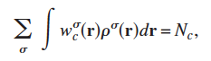
Constrained-DFT* (CDFT) approach
Constrained DFT excited state
DFT ground state
KS equation
(1)
Additional potential
(2)
Constrained in the density
*T. Van Voohis et al. Phys. Rev. A, 72, 024502 (2005); J. Phys. Chem. A, 110, 9212 (2006); Chem. Rev., 112, 321 (2012).

Slide 34
Procedure is based on total energy differences
CDFT
DFT
E⁺_{CT}(d)
DFT
CDFT
E⁻_{CT}(d)
Notes:
Mention: important advantage, we consider DFT total energies, which are accurate!!

Slide 35
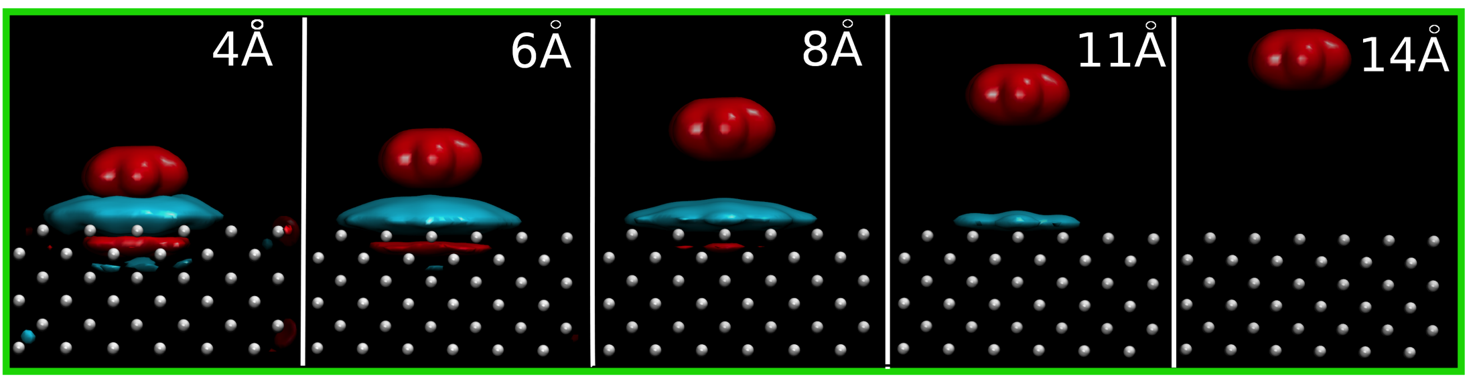
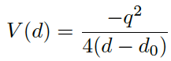
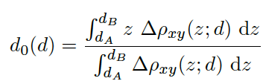
Comparison to classical image charge model
Charge density differences
By fitting z₀ to GW calculations for the same system gives 1.72Ang.
J. M. Garcia-Lastra et al. Phys. Rev. B, 80, 245427 (2009).
Notes:
Mention: CDFT allows to extract G0

Slide 36
Benzene on Li
-EA
-IP
Souza at al., Phys. Rev. B, 165112 (2013)

Slide 37
How can we capture image charge effect in practice?
Image charge model from CDFT to extract required shift
ASIC: reduce the amount of self-interaction correction added
Hybrid functionals: reduce amount of HF exchange
Scissor operator (DFT+Σ): adjust gap by hand…
GW (computationally expensive…)
Note: for molecules lying flat on a metal surface LDA/GGA often get right energy level alignment by error cancellation
Notes:
Mention: note on the speed of the image charge formation
Mention: new functionals

Slide 38
Example: BDT between Au electrodes
Experiment: G=0.01 G₀
A. M. Souza et al., Nanoscale (2014)

Slide 39
Strong versus weak coupling
Notes:
39
Mention: now we have the levels at equilibrium in the right place, are we done? No!!
What about limitations of NEGF itself?

Slide 40
Strong coupling: molecules on surfaces
Melamine on Cu: STM measurements
T. Ohto et al., PRB 87, 205439 (2013)
Notes:
Mention: metallic point contacts work really well, graphene, carbon nanotubes

Slide 41
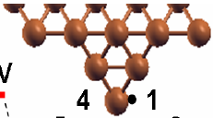
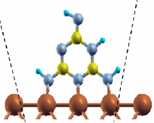
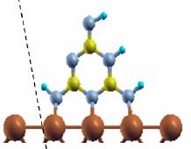
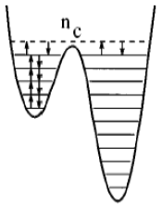
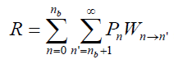
Switching rates..
T. Ohto et al., PRB 87, 205439 (2013)
Notes:
Mention: electron-phonon couplings, find relevant phonon modes for rotation, bias induced energy barrier changes, …
Just to show that the calculations do not end when we have T and I-V

Slide 42
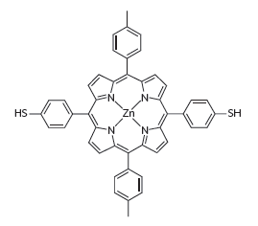
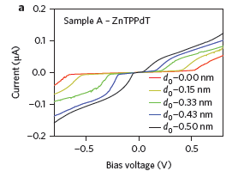
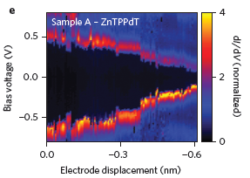
Image charge effect demonstrated experimentally
Weak coupling: Coulomb blockade
M. L. Perrin et al., Nature Nanotech. 8, 282 (2013)
Notes:
42
Mention:
Mention:-> put it as question to students
->the gap closes; note that the shape of I-V doe not really change significantly, which implies that the couplings stay constant (and energy shifts), contrary to what said yesterday!!
Molecule name: Zn-porphyrin

Slide 43
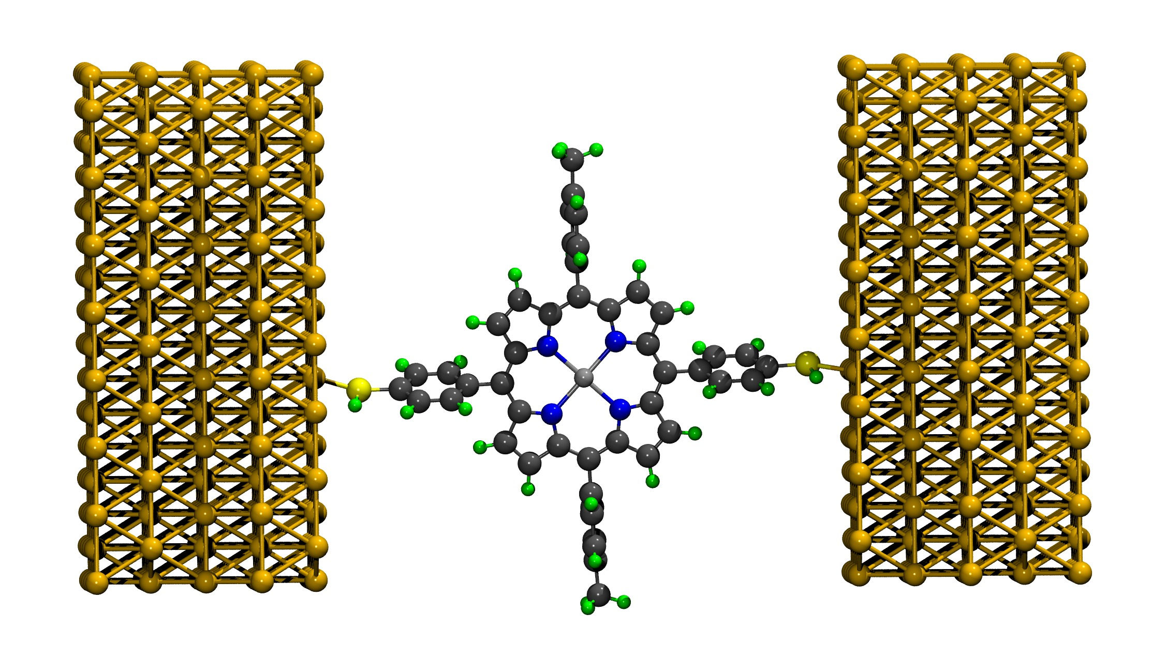
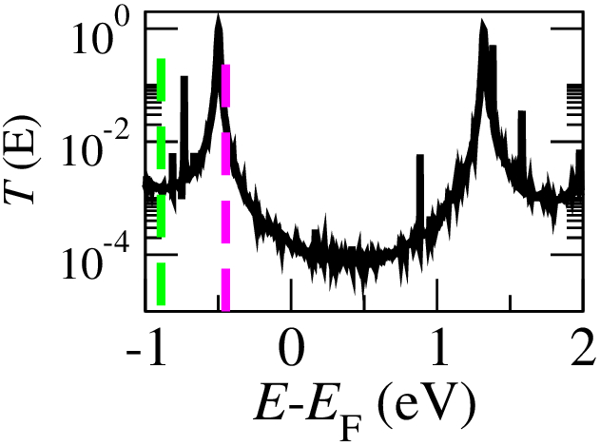
Image charge effect demonstrated experimentally
IP(gas phase)
IP (on surface)
DFT more or less gets the HOMO energy right when compared to Delta-SCF+Image charge model
Exp: 0.5 eV
Notes:
43

Slide 44
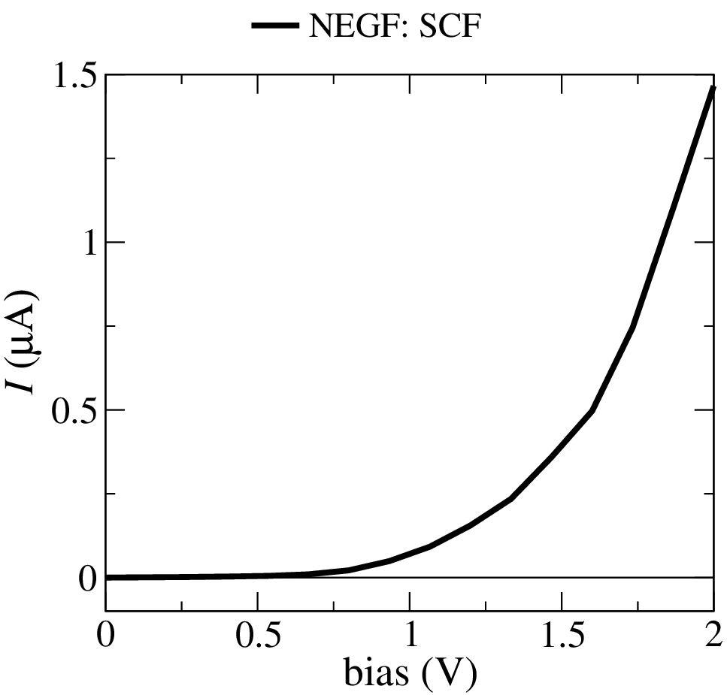
Current vs. voltage
I-V has the onset of current at approximately the right voltage
However it increases parabolically, while in experiment there is a jump at the onset
Notes:
44

Slide 45
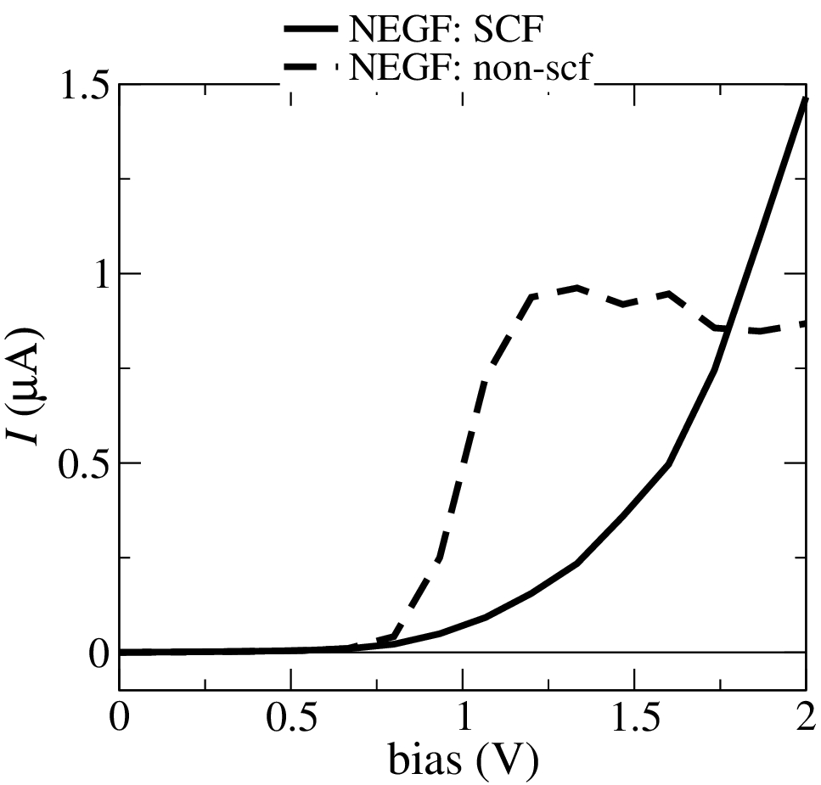
Transmission vs. bias
Lack of derivative discontinuity of the potential
Notes:
45
Mention: energy level shifts with bias: fractional charge
->draw on board charge vs. bias
Non-self-consistent I-V has correct sudden onset in current
Current is overestimated, in experiment the electronic coupling is weaker: different binding geometry?

Slide 46
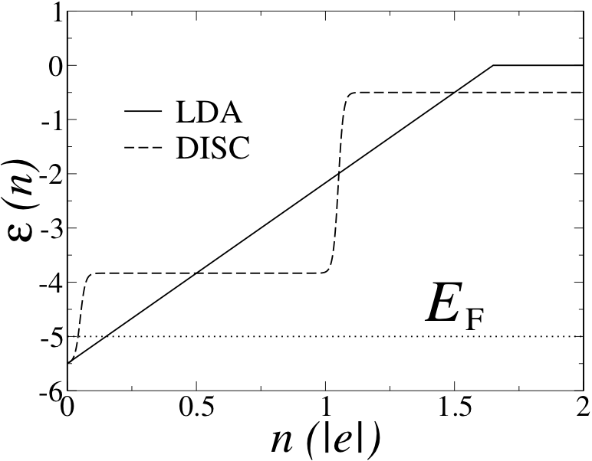
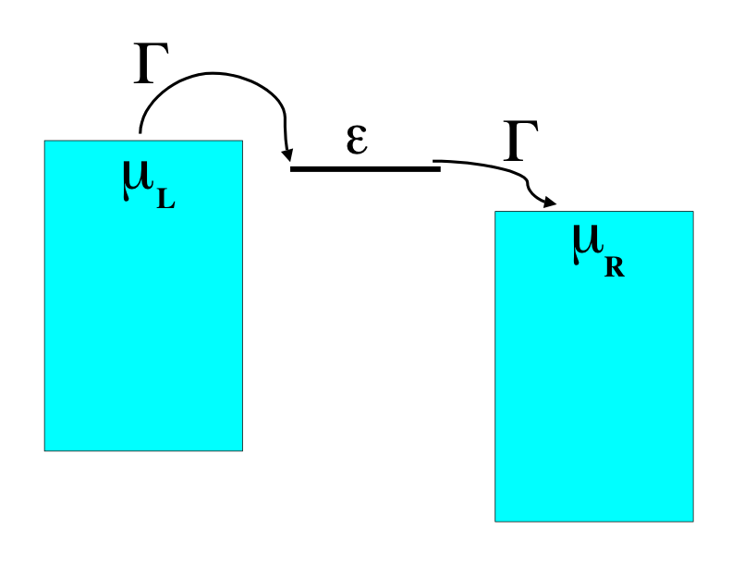
GGA/LDA miss the derivative discontinuity!
For strong coupling eigenvalue rises linearly with charging
For weak coupling the eigenvalue has to change discontinuously at integer occupations, but for fractional occupations it needs to stay constant
C. Toher, A. Filippetti, S. Sanvito and K. Burke, Phys. Rev. Lett. 95, 146402 (2005)
Notes:
46
Mention:
Ask students?
-> draw on board: atom on surface and isolated atom (or H2 molecule)
-> importantn to note: the charge n is the “probability to find an electron on the dot”
-> emphasize that you can get good conductance at low bias as long as you are in the tunnelling

Slide 47
For weakly coupled systems it is more appropriate to use Master equation transport Parameters can be extracted from DFT/NEGF
Notes:
47

Slide 48
Coulomb blockade regime
LUMO
Energy
μ1
μ2
γ
γ
HOMO
Au
Au
Notes:
Mention we now reduce the coupling until the broadening is very small
Gamma=1/time - > it takes a long time for an electron to jump on/off the molecule, so that it can diphase on the molecule
Transport is then more suitably not coherent but with the dephasing we have a two step hopping process; sequential tunneling

Slide 49



Master equation
We consider transitions between a discrete set of states
Initial states has energy E_{i}, the final state has energy E_{f}.
Transition rates
μ1
μ2
γ
γ
Energy
What do we need?
Au
H_{T}
H_{T}
Au
Occupation probability of state m
Notes:
Mention:
key point: E_i are total energies, not eigenvalues

Slide 50


Pauly Master Equation
Steady state:
0
Total current

Slide 51

First order in H_{T}: sequential tunneling
0
μ1
μ2
EF
γ
γ
Au
Au
Energy
Non-coherent
(hopping transport)
or sequential tunnelling
V≠0
V=0
Notes:
Mention: we neglect spins here for simplicity

Slide 52
Second order in H_{T}: co-tunneling
Two particle process:
initial state intermediate state final state
μ1
μ2
EF
γ
γ
Au
Au
Energy
V≠0
coherent or tunneling
transport

Slide 53
What do we need from DFT? 1)Coupling constants to electrodes 2)Total energy differences
Notes:
53

Slide 54



How to change the distance?

Slide 55

1)Extract Γ_{L} and Γ_{R} from Smeagol:
FWHM= Γ_{L} + Γ_{L}
Notes:
Mention: how do we get gamma
it can change with bias, but we neglect that for now
We checked non-selfconsistently, and more or less the peaks did not change width

Slide 56

2)Total energy differences
Image charge model based on Constrained DFT

Slide 57

Let’s compare to experiment
Notes:
Mention:
-> tip geometry reduces coupling by factor 3
-> general stuff on mapping to model: maybe show a slide on organic electronics where this is done, then also to include phonons, then to get to Markus theory
-> the slope after the first jump can be due to other energy levels, or also excitation of phonons
Temperature of experiments 4K, calculations at 150 K

